Slide 1
OSA and Hypoventilation Literature Review

Slide 2
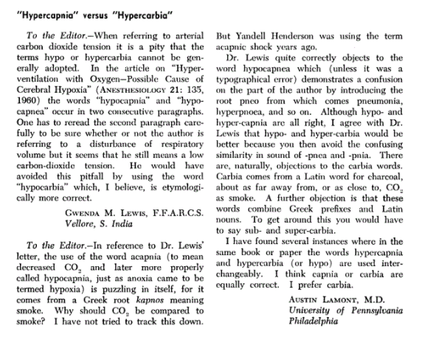
https://pubs.asahq.org/anesthesiology/article/22/2/324/15815/Hypercapnia-versus-Hypercarbia

Slide 3
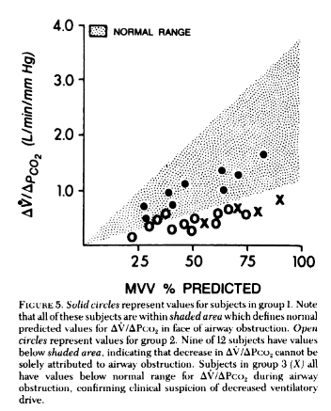
Fahey PJ, Hyde RW. “Won’t breathe” vs “can’t breathe”. Detection of depressed ventilatory drive in patients with obstructive pulmonary disease. Chest 1983;84:19-25. PMID: 6407808
Can’t breathe - won’t breathe distinction initially noted between whether patients with hypercapnia were generating the maximal amount of ventilation they could.

Slide 4
New set point: Long term facilitation
Ventilatory Long-Term-Facilitation: generally an INCREASED CO2 response in response to intermittent hypoxemia.
Is there a converse term for decreased ventilatory responsiveness in response to hypercapnia?
Although ventilatory LTF has not been reported as such in OSA patients, when compared to age, sex and BMI matched non-OSA participants, untreated OSA patients exhibit a reduced P_{ET}CO₂, reduced CO₂ reserve and increased CO₂ sensitivity below eupnea, which reflects the expression of ventilatory LTF and ventilatory feedback (47, 55). Following CPAP treatment P_{ET}CO₂ and the CO₂ reserve increased in the OSA patients, further supporting the possible presence of ventilatory LTF in untreated OSA patients (47).
x ] https://www.frontiersin.org/articles/10.3389/fneur.2018.00896/full
Notes:
[ ] 47 - Salloum A, Rowley JA, Mateika JH, Chowdhuri S, Omran Q, Badr MS. Increased propensity for central apnea in patients with obstructive sleep apnea: effect of nasal continuous positive airway pressure. Am J Respir Crit Care Med. (2010) 181:189–93. doi: 10.1164/rccm.200810-1658OC
[ ] 55 - Chowdhuri S, Shanidze I, Pierchala L, Belen D, Mateika JH, Badr MS. Effect of episodic hypoxia on the susceptibility to hypocapnic central apnea during NREM sleep. J Appl Physiol. (2010) 108:369–77. doi: 10.1152/japplphysiol.00308.2009

Slide 5
Current classification scheme: chronic = OHS
When OSA occurs in conjunction with chronic hypercapnia – it is termed obesity hypoventilation syndrome if there are no other contributing factors. (it should be noted, that 10% of patients meeting OHS criteria do not have diagnosable OSA)
However, there are no unique symptoms that differentiate OHS from OSA. Can be considered as a spectrum of abnormality as in the ERS classification system.
Vs Component cause chronic hypercapnia
Vs Acute (or acute recurrent hypercapnia; or acute on chronic?)

Slide 6
Why might hypercapnic respiratory failure commonly result from sleep disordered breathing?
1. Loss of the wakefulness drive to breath
2. Lower chemoreflex sensitivity
Numerous studies have documented blunted responsiveness to CO2 during sleep attributable to both an increase in the set point for CO2 and to a decrease in the ventilatory response slope to increasing PCO2. 7–11 (from doi:10.1016/j.jsmc.2014.05.014 )
In addition to changes in body mechanics making the reserve smaller
This occurs first/mostly in REM (both because drive and mechanics are most altered)
REM sleep hypoventilation is the first to develop, as ventilation in this stage of sleep is dependent on only the diaphragm and the central drive to breath. (normal PaCO2 increased 4-6 mmHg)
So more properly, anything cause daytime hypercapnia is likely to show up as nocturnal hypercapnia first.
Notes:
Relation of sleep to overall hypercapneic failure: (https://onlinelibrary.wiley.com/doi/full/10.1111/resp.12376)
the main reason for the particular vulnerability to hypoventilation during sleep is that sleep is associated with diminished ventilatory drive, particularly during rapid eye movement (REM) sleep

Slide 7
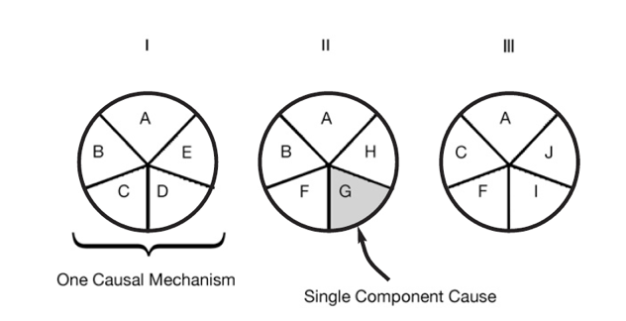
Sufficient-Component Cause Model
Sufficient cause: a set of factors that will cause disease when present
Component cause: a factor that, if not present, no disease would occur
Necessary cause: in all sufficient cause sets, this component must be present
3 Different Sufficient Causes
A = Necessary Cause
A – J = Component Cause
Notes:
Hypothesis
Rothman KJ. Am J Epidemiol 1976; 104: 587-592.
a sufficient cause as "...a complete causal mechanism" that "inevitably produces disease." Consequently, a "sufficient cause" is not a single factor, but a minimum set of factors and circumstances that, if present in a given individual, will produce the disease.

Slide 8
Causes of Hypercapnia: Hypothesis
Sleep Apnea as Component Cause
Obesity as Component Cause
Obesity Hypovent
COPD as Component Cause
Loop Diuretics as Component Cause
Severe COPD
ALS
Opiates as Component Cause
Muscular weakness as Component Cause
Notes:
Hypercapnic respiratory failure is uncommon and can be acute or chronic.
The symptoms are variable, and the diagnosis is frequently missed.
Each case of hypercapnic respiratory failure may have several necessary causes.
Prior research exclusively focused on sufficient causes
Perhaps effect modification?
Patients who develop hypercapnic respiratory failure have many comorbidities that may act as confounders

Slide 9
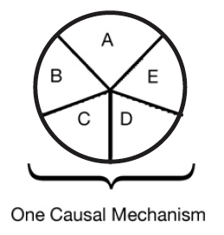
Multicausality
Hypothetical patient with hypercapnic respiratory failure
Sufficient cause: a set of factors that will cause disease when present
Component cause: a factor that, if not present, no disease would occur
Necessary cause: in all sufficient sets, this component must be present
COPD
Obesity
Loop diuretic
Untreated
Sleep Apnea
Opiates
Notes:
“Perhaps the most important of these principles is self-evident from the model: A given disease can be caused by more than one causal mechanism, and every causal mechanism involves the joint action of a multitude of component causes”’
“The importance of multicausality is that most identified causes are neither necessary nor sufficient to produce disease. Nevertheless, a cause need not be either necessary or sufficient for its removal to result in disease
prevention. If a component cause that is neither necessary nor sufficient is blocked, a substantial amount of disease may be prevented."
Rothman and Greenland

Slide 10
Notes:
Rothman, K. J., & Greenland, S. (2005). Causation and causal inference in epidemiology. American journal of public health, 95(S1), S144-S150

Slide 11
Untreated OSA and hypoventilation disorders: mechanisms of interaction
Hypercapnic drive to breath decreased by narcotics and sleep. Decreased by sleep deprivation (Cooper KR, Phillips BA. Effect of short-term sleep loss on breathing. J. Appl. Physiol. 1982; 53: 855–8.)
Notes:
[ ] Cooper KR, Phillips BA. Effect of short-term sleep loss on breathing. J. Appl. Physiol. 1982; 53: 855–8.
[ ] Skatrud JB, Dempsey JA, Bhansali P, Irvin C. Determinants of chronic carbon dioxide retention and its correction in humans. J Clin Invest 65: 813-821, 1980.
[ ] Skatrud JB, Dempsey JA, Iber C, Berssenbrugge A. Correction of CO2 retention during sleep in patients with chronic obstructive pulmonary diseases. Am Rev Respir Dis 124: 260-268, 1981.
particularly if associated with obesity and/or obstructive sleep apnoea (OSA) (‘overlap syndrome’).4, 7, 8

Slide 12
OSA that is severe can lead to hypercapnia
During apneic events there is no ventilation. Thus, in order to maintain eucapnia, hyperventilation has to make up this deficit. If inter-event duration is >3:1, accumulation can occur. If this goes on, the bicarbonate retention may lead to daytime hypercapnia
Berger KI, Ayappa I, Sorkin IB, Norman RG, Rapoport DM, Goldring RM. CO(2) homeostasis during periodic breathing in obstructive sleep apnea. J. Appl. Physiol. (1985) 2000; 88: 257–264.
Norman RG, Goldring RM, Clain JM, Oppenheimer BW, Charney AN, Rapoport DM, Berger KI. Transition from acute to chronic hypercapnia in patients with periodic breathing: predictions from a computer model. J. Appl. Physiol. (1985) 2006; 100: 1733–1741.
Ayappa I, Berger KI, Norman RG, Oppenheimer BW, Rapoport DM, Goldring RM. Hypercapnia and ventilatory periodicity in obstructive sleep apnea syndrome. Am J Respir Crit Care Med. 2002;166(8):1112-1115

Slide 13
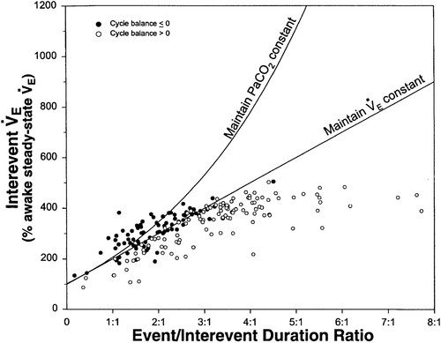
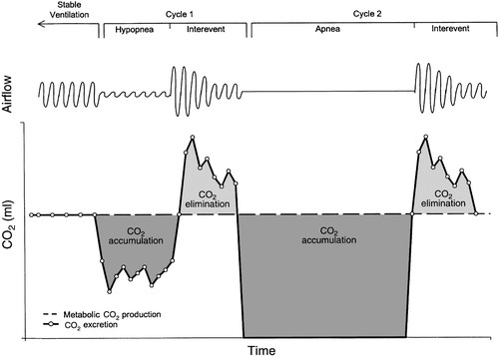
Contribution of Apneas – CO2 loading and unloading
Notes:
(this explains why CPAP works in most OHS) https://doi.org/10.1152/jappl.2000.88.1.257
No relationship was seen between the CO₂ balance for each cycle and its interevent tidal volume or interevent ventilation. Positive CO₂ balance was not associated with a low interevent ventilation and occurred despite increased interevent ventilation to rates as high as 45 l/min.’
Thus, the authors infer the pathophysiology relates to **temporal** V/Q mismatching (as apposed to the usual **spatial** V/Q mismatch), rather than overall inability to compensate.
This is why they used Mixed Venous CO2 as a check – to ensure that temporal V/Q mismatching wasn’t compensated through changes in cardiac output
As the relative duration of the event increased (increasing ratios), there was a progressive increase in the interevent ventilation to a plateau at ratios >3:1. This plateau occurred at an interevent ventilation that was 450% of the awake steady-state value and reflects the maximum ventilation achieved by any patient during the interevent periods.
=➔ this would be different in someone who has pulmonary disease (or deconditioning) – limited in ability to increase
A model has been proposed where daytime hypercapnia can develop if sleep disordered breathing duration is sufficiently long or interapnea periods too short to restore ventilation and eucapnia (Berger et al., 2000). Berger and colleagues have suggested that gradual elevations in CO₂ occur over time since the ventilatory response to hypercapnia is insufficient compared to the rise in CO₂ which occurs during sleep.

Slide 14
OHS pathophysiology
Complex and multifactorial:
Can’t breathe components (limited ability to increase ventilation) from external compression of the thorax, increased VO2 creation due to enlarged body size.
However, most patients with BMI < 50 don’t have spirometric abnormalities; obese patients are often able to voluntarily decrease their PaCO2 to normal range by volitional hypoventilation.
Won’t breathe components
OHS differentiated from obese by decreased HCVR – though unclear if this is cause or effect
Role of Leptin here?
HCO3 retention in the day (ie. diuretics or renal dysfunction)
Mechanisms that explain why HCVR not fully explored; may relate to sensitization; inherent optimization for increased work of breathing
May be some variation of how much is attributable to severe OSA vs respiratory mechanic issues between different people diagnosed with OHS.
Notes:
[ ] phenotyping OHS by the severity of OSA?

Slide 15
Verbraecken and McNicholas: Respiratory mechanics and ventilatory control in overlap syndrome and obesity hypoventilation. Respiratory Research 2013 14:132. doi:10.1186/1465-9921-14-132 https://link.springer.com/content/pdf/10.1186/1465-9921-14-132.pdf
“In subjects with chronic hypercapnia, there is an increased blood bicarbonate concentration, which may inhibit the ventilatory response to CO2 and decreases mouth occlusion pressure response during wakefulness and sleep [50]. When normocapnic, overlap patients can however have a normal or even enhanced ventilatory response to CO2 [51]. This is in contrast to the data on decreased hypercapnic (HCVR) and hypoxic (HVR) ventilatory response in OHS, as compared to obese, non-hypercapnic subjects [52].” – all these are pretty old references
Differentiation of OHS and OVS
OVS: can be non-obese, can have either maintained/elevated chemical drive to breath or decreased drive to breath
Reflects the gradual adaptation of chemoreceptors to hypercapnia / HCO3 elevation.
OHS: must be obese, must not have another chronic pulmonary condition; generally, seems to be mediated by a decreased drive to breath
Obesity: default is increased HCVR; if this fails, you get OHS *** find citation for this.
Notes:
50 – 52
50. Radwan L, Maszczyk Z, Koziorowski A, Koziej M, Cieslicki J, Sliwinski P,
Zielinski J: Control of breathing in obstructive sleep apnoea and in
patients with the overlap syndrome. Eur Respir J 1995, 8:542–545.
51. Verbraecken J, De Backer W, Willemen M, De Cock W, Wittesaele W,
Van de Heyning P: Chronic CO2 drive in patients with obstructive sleep
apnea and effect of CPAP. Respir Physiol 1995, 101:279–287.
52. Zwillich CW, Sutton FD, Pierson DJ, Greagh EM, Weil JV: Decreased hypoxic
ventilatory drive in the obesity hypoventilation syndrome. Am J Med
1975, 59:343–348.

Slide 16
Verbraecken and McNicholas: Respiratory mechanics and ventilatory control in overlap syndrome and obesity hypoventilation. Respiratory Research 2013 14:132. doi:10.1186/1465-9921-14-132 https://link.springer.com/content/pdf/10.1186/1465-9921-14-132.pdf
Spirometric abnormalities re: OHS pathogenesis
Note: for the purposes of this manuscript, it may make sense to point out that these are CONSEQUENCES of respiratory derangments, not consequences of them
“Various compensatory mechanisms are adopted by morbidly obese subjects to maintain eucapnia, despite chronically loaded breathing [82], but are impaired or overwhelmed in OHS.
Piper AJ, Grunstein RR: Big breathing: the complex interaction of obesity, hypoventilation, weight loss, and respiratory function. J Appl Physiol 2010,108:199–205.
Summary of Spirometry changes:
FVC, TLC, RV – 0.5% decrease per BMI
FRC and ERV – 1% decrease per BMI unit
99. Jones RL, Nzekuwu MU: The effects of body mass index on lung volumes. Chest 2006, 130(3):827–833.
Due to ventilating at a lower volume, compliance decreases by:
20% in eucapnic obese
60% in hypercapnic obese (OHS only) - so possibly some component of can’t breathe
[110.] Sharp JT, Henry JP, Sweany SK, Meadows WR, Pietras RJ: The total work of breathing in normal and obese men. J Clin Invest 1964, 43:728–739.
Abdominal obesity, particularly when the patient is supine – also increased respiratory system inertance – leading to three fold increase work of breathing
[110,115]. 115. Lee MY, Linn CC, Shen SY, Chiu CH, Liaw SF: Work of breathing in eucapnic and hypercapnic sleep apnea syndrome. Respiration 2009, 77:146–153

Slide 17
Verbraecken and McNicholas: Respiratory mechanics and ventilatory control in overlap syndrome and obesity hypoventilation. Respiratory Research 2013 14:132. doi:10.1186/1465-9921-14-132 https://link.springer.com/content/pdf/10.1186/1465-9921-14-132.pdf
Ventilation control abnormalities in OHS
VO2 higher, even at rest. Thus, higher drive to breath required [126, 127]
OHS patients fail to increase [52, 95]; can voluntarily regain eucapnia [86]
“hypercapnic ventilatory response is < 1 l/min/mmHg in OHS, between 1.5 and 2.5 l/min/mmHg in eucapnic obese individuals and 2-3 l/min/mmHg in healthy subjects [51,128,129].”
Improves with PAP [130, 131]
“It has been hypothesized that elevated leptin levels may be a compensatory mechanism by which obese subjects remain normocapnic, but resistance to leptin may develop [140].”
“Strikingly, leptin levels are a better predictor of hypercapnia than the degree of adiposity [148]”
Notes:
86 - 86. Leech J, Önal E, Aronson R, Lopata M: Voluntary hyperventilation in obesity hypoventilation. Chest 1991, 100:1334–1338.
51 - 51. Verbraecken J, De Backer W, Willemen M, De Cock W, Wittesaele W, Van de Heyning P: Chronic CO2 drive in patients with obstructive sleep apnea and effect of CPAP. Respir Physiol 1995, 101:279–287.
126. BaHamman A: Acute ventilatory failure complicating obesity hypoventilation: update on a ‘critical care syndrome’. Curr Opin Pulm Med 2010, 16:543–551.
127. Steier J, Jolley CJ, Seymour J, Roughton M, Polkey MI, Moxham J: Neural respiratory drive in obesity. Thorax 2009, 64:719–725.
128. Rapoport DM, Garay SM, Epstein H, Goldring RM: Hypercapnia in the obstructive sleep apnea syndrome: a reevaluation of the “Pickwickian syndrome”. Chest 1986, 89:627–635.
129. Berthon-Jones M, Sullivan CE: Time course of change in ventilatory response to CO2 with long-term CPAP therapy for obstructive sleep apnea. Am Rev Respir Dis 1987, 135:144–147.
130. Lin CC: Effect of nasal CPAP on ventilatory drive in normocapnic and hypercapnic patients with obstructive sleep apnoea syndrome. Eur Respir J 1994, 7:2005–2010.
131. De Lucas-Ramos P, de Miguel-Diez J, Santacruz-Siminiani A, González-Moro JM, Buendía-García MJ, Izquierdo-Alonso JL: Benefits at 1 year of nocturnal intermittent positive pressure ventilation in patients with obesity hypoventilation syndrome. Respir Med 2004, 98:961–967
140 - 140. Lévy P, Pépin JL, Arnoud C, Tamisier R, Borel JC, Dematteis M, Godin-Ribuot D, Ribuot C: Intermittent hypoxia and sleep-disordered breathing: current concepts and perspectives. Eur Respir J 2008, 32:1082–1095.
148 - 148. Redolfi S, Corda L, La Piana G, Spandrio S, Prometti P, Tantucci C: Long-term non-invasive ventilation increases chemosensitivity and leptin in obesity hypoventilation syndrome. Respir Med 2007, 101:1191–1195.
The development of awake hypercapnia has been shown to correlate strongly with the proportion of sleep time spent less than 90% SaO2 [97]
97. Kaw R, Hernandez AV, Walker E, Aboussouan L, Mokhlesi B: Determinants of hypercapnia in obese patients with obstructive sleep apnea: a systematic review and metaanalysis of cohort studies. Chest 2009,
136:787–796
In a recent study it was confirmed that patients with higher bicarbonate concentration had a more blunted CO2 response [135]
135 - 135. Raurich JM, Rialp G, Ibanez J, Llompart-Pou JA, Ayestaran I: Hypercapnic respiratory failure in obesity hypoventilation syndrome: CO2 response and acetazolamide treatment effects. Repir Care 2010, 55(11):1442–1448

Slide 18
Untreated OSA and hypoventilation disorders: individual effects
Note: because OHS is defined as requiring the development of hypercapnic respiratory failure for diagnosis, it will have a worse morbidity than the overlap syndrome, which allows for patients both with respiratory failure, and those who have not developed it.
Thus, OVS only develops the ventilation control issues present in all cases of OHS at the end-stage.

Slide 19
Untreated OSA and hypoventilation disorders: societal effects
90% of patients with OSA have OSA, with the remainder having sleep hypoventilation - Olson AL, Zwillich C: The obesity hypoventilation syndrome. Am J Med 2005, 118:948–956.
- add this to earlier slide
Conversely, only <25% with OSA and BMI over 40 develop OHS – thus clearly these are both component causes.
[ ] Review: Laaban JP, Chailleux E. Daytime hypercapnia in adult patients with obstructive sleep apnea syndrome in France, before initiating nocturnal nasal continuous positive airway pressure therapy. Chest 2005; 127: 710–715.
Notes:
In a large study of patients with OSAS, Laaban and Chailleux found 11% to be hypercapnic. Risk factors for hypercapnea in this study included higher BMI and reduced FVC
Though 7.2% of hypercapneic OSAS had BMI < 30. COPD was excluded.
BMI, VC, PaO2 only explain <10% PaCO2 variance.
Laaban JP, Chailleux E. Daytime hypercapnia in adult patients with obstructive sleep apnea syndrome in France, before initiating nocturnal nasal continuous positive airway pressure therapy. Chest 2005; 127: 710–15.

Slide 20
Societal burdens.
Both syndromes share a high prevalence, namely 10 to 20% for OHS in patients with OSA [96]
COPD found in 10% with OSA - [20-24 – 24 best].
The prevalence of overlap and OHS in the general population is estimated to be 1% and 0.37% respectively [20-23,96-98].
Effects:
[x]Overlap patients also more often present with COPD exacerbations than simple COPD patients (relative risk of 1.70) [16] and show a trend to less prednisolone use after treatment [28]. OHS patients who refused treatment with noninvasive ventilation, had a mortality rate of 46% over an average follow-up period of 50 months [88]. In overlap, reduced survival was reported in those refusing CPAP therapy (relative risk of 1.79) [15,184] of treatment
Notes:
96 96. Nowbar S, Burkart KM, Gonzales R, Fedorowicz A, Gozansky WS,
Gaudio JC, Taylor MR, Zwillich CW: Obesity-associated hypoventilation
in hospitalized patients: prevalence, effects, and outcome. Am J Med
2004, 116:1–7
20. Guilleminault C, Cummiskey J, Motta J: Chronic obstructive airflow disease
and sleep studies. Am Rev Respir Dis 1980, 122:397–406.
21. Chaouat A, Weitzenblum E, Krieger J, Ifoundza T, Oswald M, Kessler R:
Association of chronic obstructive pulmonary disease and sleep apnea
syndrome. Am Rev Respir Dis 1995, 151:82–86.
22. Bradley TD, Rutherford A, Grossmann RF, Lue F, Zamel N, Moldosfsky H,
Phillipson EA: Role of daytime hypoxemia in the pathogenesis of right
heart failure in the obstructive sleep apnea syndrome. Am Rev Respir Dis
1985, 131:835–839.
23. Bradley TD, Rutherford A, Lue F, Moldofsky H, Grossmann RF, Zamel N,
Phillipson EA: Role of diffuse airway obstruction in the hypercapnia of
obstructive apnea. Am Rev Respir Dis 1986, 134:920–924.
24. Sanders MH, Newman AB, Haggerty CL, Redline S, Lebowitz M, Samet J,
O'Connor GT, Punjabi NM, Shahar E: Sleep heart health study: sleep and
sleep-disordered breathing in adults with predominantly mild obstructive
airway disease. Am J Respir Crit Care Med 2003, 167:7–14.
96. Nowbar S, Burkart KM, Gonzales R, Fedorowicz A, Gozansky WS,
Gaudio JC, Taylor MR, Zwillich CW: Obesity-associated hypoventilation
in hospitalized patients: prevalence, effects, and outcome. Am J Med
2004, 116:1–7.
97. Kaw R, Hernandez AV, Walker E, Aboussouan L, Mokhlesi B: Determinants
of hypercapnia in obese patients with obstructive sleep apnea: a
systematic review and metaanalysis of cohort studies. Chest 2009,
136:787–796.
98. Mokhlesi B, Saager L, Kaw RQ: Should we routinely screen for hypercapnia
in sleep apnea patients before elective noncardiac surgery? Cleve Clin J
Med 2010, 77:60–61.
16 16. Marin JM, Soriano JB, Carrizo SJ, Boldova A, Celli BR: Outcomes in patients
with chronic obstructive pulmonary disease and obstructive sleep apnea:
the overlap syndrome. Am J Respir Crit Care Med 2010, 182(3):325–331.
88. de Llano Pérez LA, Golpe R, Ortiz Piquer M, Veres Racamonde A, Vázquez
Caruncho M, Caballero Muinelos O, Alvarez Carro C: Short-term and longterm
effects of nasal intermittent positive pressure ventilation in patients
with obesity-hypoventilation syndrome. Chest 2005, 128:587–594.
15. Marin JM, Carrizo SJ, Vicneti E, Agusti AG: Long-term cardiovascular
outcomes in men with obstructive sleep apnoea-hypopnoea with or
without treatment with continuous positive airway pressure: an
observational study. Lancet 2005, 365:1046–1053.
184. Machado MC, Vollmer WM, Togeiro SM, Bilderback AL, Oliveira MV, Leitão FS,
Queiroga F Jr, Lorenzi-Filho G, Krishnan JA: CPAP and survival in
moderate-to-severe obstructive sleep apnoea syndrome and hypoxaemic
COPD. Eur Respir J 2010, 35(1):132–137.

Slide 21
[ ] 1 - . Mokhlesi B, Tulaimat A, Faibussowitsch I, et al. Obesity hypoventilation syndrome: prevalence and predictors in patients with obstructive sleep apnea. Sleep Breath 2007;11:117–24.
[ ] Patients with OHS have higher healthcare utilization than comparable eucapnic obese patients - The use of health-care resources in obesity-hypoventilation syndrome.Berg G, Delaive K, Manfreda J, Walld R, Kryger MH Chest. 2001 Aug; 120(2):377-83.

Slide 22
Obesity as shared (or component) cause
Sleep is a period of vulnerability to the respiratory system in the obese: due to recumbent position (abdominal girth -> greater reduction in the already reduced ERV).
This can predispose to reduced tracheal traction on the pharynx -> increased collapsibility of the upper airway.
Additively, can lead to sleep hypoventilation, which in turn predisposes to hypoventilation.

Slide 23
PMID: 30359410
Acute Hypercap survivors Geneva 2012-2015 (n=197) -> 78 enrolled. 53 completed sleep study 3 months after discharge. AHI 20+ used for dx. Spiro, STOP-Bang also performed.
36 had Mod-severe OSA, 17 had no or mild OSA.
Univeriate Analsysi: FEV1 & RV/TLC better (collider bias?), BMI higher. No diff in symptoms, Age, gender, comorbidities
Multivariate: FEV1, RV/TLC, ESS (ish), neck circumference indep predictors
STOP-BANG = AUROC 0.58!!! (worthless)
Notes:
The combination of a cluster of comorbidities, including OSA and COPD, has been associated with a higher risk of death and early readmission after discharge for AHRF [7]
Adler D, Pepin JL, Dupuis-Lozeron E, Espa-Cervena K, Merlet-Violet R, Muller H, et al. Comorbidities and Subgroups of Patients Surviving Severe Acute Hypercapnic Respiratory Failure in the Intensive Care Unit. Am J Respir Crit Care Med. 2017;196(2):200–7. Epub 2016/12/16. 10.1164/rccm.201608-1666OC .
“Upper airway inflammation consecutive to smoking, rostral fluid shift, upper airway muscle weakness and inhaled corticosteroids may promote OSA in COPD patients, while other factors may be protective, such as a low BMI and a diminished rapid-eye movement sleep stag”
Following AHRF, we demonstrated that comorbidities are under-recognized and associated with poor outcome, despite patients being frequently hospitalized¹⁵.

Slide 24
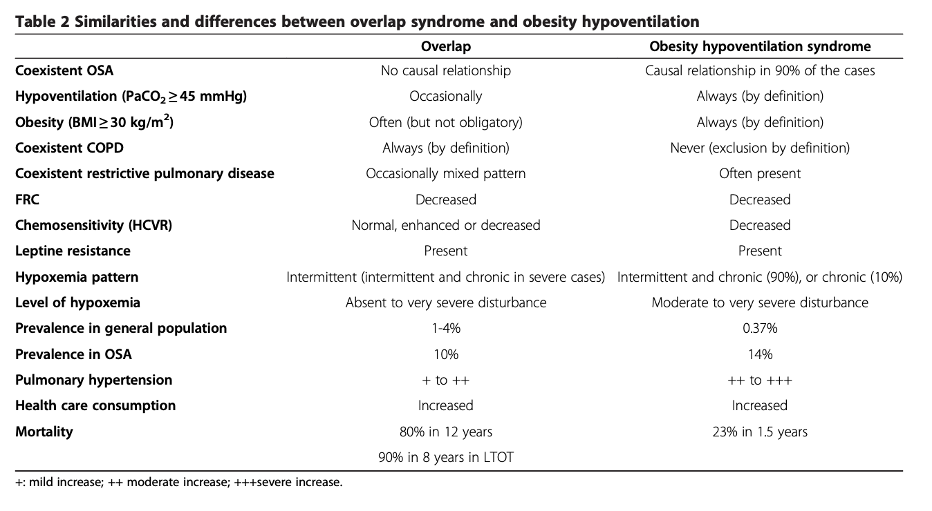
Differentiating OVS and OHS
doi:10.1186/1465-9921-14-132 Cite this article as: Verbraecken and McNicholas: Respiratory mechanics and ventilatory control in overlap syndrome and obesity hypoventilation. Respiratory Research 2013 14:132.
https://link.springer.com/content/pdf/10.1186/1465-9921-14-132.pdf
Notes:
Are they diff? However, they are also quite distinct from each other in a sense that obesity is not always present in overlap syndrome, and chemical drive can be preserved, while OSA is not always present in obesity hypoventilation, and COPD is an exclusion criterion in the definition of OHS.
Meta-analysis on factors on predicting OSA in COPD
➔ https://doi.org/10.1016/j.smrv.2016.10.004
From above citation:
“Chronic daytime hypercapnia would emerge if both the acute ventilatory compensation for transient nocturnal hypercapnia is compromised, as well as the bicarbonate excretion, as might be seen under condition of hypoxia (f.i. chest infection), diuretic therapy, or heart failure [170,178]. This makes both patient categories more susceptible to acute ventilatory failure [126]. Despite this, the diagnosis of overlap syndrome and of OHS appears to be often overlooked, especially in a clinical setting when dealing with the other illnesses of these patients [189].
“
In subjects with chronic hypercapnia, there is an increased blood bicarbonate concentration, which may inhibit the ventilatory response to CO2 and decreases mouth occlusion pressure response during wakefulness and sleep [50]. When normocapnic, overlap patients can however have a normal or even enhanced ventilatory response to CO2 [51]. This is in contrast to the data on decreased hypercapnic (HCVR) and hypoxic (HVR) ventilatory response in OHS, as compared to obese, non-hypercapnic subjects [52].
Hypoxemia and hypercapnia are however less severe in patients with overlap than in patients with OHS [54].
Effectively, daytime hypercapnia is more common in overlap syndrome as compared to simple OSA [23]. However, a correlation between hypercapnia and the frequency and duration of respiratory events during the night could not be observed [72,73].
23 Bradley TD, Rutherford A, Lue F, Moldofsky H, Grossmann RF, Zamel N, Phillipson EA: Role of diffuse airway obstruction in the hypercapnia of obstructive apnea. Am Rev Respir Dis 1986, 134:920–924.
50 Radwan L, Maszczyk Z, Koziorowski A, Koziej M, Cieslicki J, Sliwinski P, Zielinski J: Control of breathing in obstructive sleep apnoea and in patients with the overlap syndrome. Eur Respir J 1995, 8:542–545
51 Verbraecken J, De Backer W, Willemen M, De Cock W, Wittesaele W, Van de Heyning P: Chronic CO2 drive in patients with obstructive sleep apnea and effect of CPAP. Respir Physiol 1995, 101:279–287.
52 Zwillich CW, Sutton FD, Pierson DJ, Greagh EM, Weil JV: Decreased hypoxic ventilatory drive in the obesity hypoventilation syndrome. Am J Med 1975, 59:343–348.
54 Kessler R, Chaouat A, Schinkewitch P, Faller M, Casel S, Krieger J, Weitzenblum E: The obesity-hypoventilation syndrome revisited: a prospective study of 34 consecutive cases. Chest 2001, 120:369–376
72 Garay SM, Rapoport D, Sorkin B, Epstein H, Feinberg I, Goldring RM: Regulation of ventilation in the obstructive sleep apnea syndrome. Am Rev Respir Dis 1981, 124:451–457.
73 Lopata M, Onal E: Mass loading, sleep apnea, and the pathogenesis of obesity hypoventilation. Am Rev Respir Dis 1982, 126:640–645.

Slide 25
Hypercapnia treatment after exacerbation slide: wait 2-4 weeks in hypercapnia COPD, immediatelely in OHS. Not known what to do in OVS.

Slide 26
Sleep disruption – impaired co2 handling
66. Li Y , Panossian LA , Zhang J , et al . Eff ects of chronic sleep fragmentation
on wake-active neurons and the hypercapnic arousal
response . Sleep . 2014 ; 37 ( 1 ): 51 - 64 .

